Slide 1



























Google Cloud Icons
Compute
Serverless
Compute Engine
Google Kubernetes Engine
VMware Engine
Bare Metal Solution
Cloud GPUs
Distributed
Cloud
Container- Optimized OS
Cloud Functions
Cloud Run
App Engine
Cloud Endpoints
API Gateway
Analytics
BigQuery
Cloud
Composer
Cloud
Data Fusion
Data Catalog
Dataflow
Dataprep by Trifacta
Dataproc
Life Sciences
Pub/Sub
Datastream
Healthcare API
Looker
Google Data Studio
Dataplex
Analytics Hub

Slide 2










Google Cloud Icons
Operations
Cloud APIs
Cloud Billing API
Cloud Deployment Manager
Cloud Logging
Cloud Monitoring
Cloud Shell
Error Reporting
Cloud Profiler
Cloud Trace
Backup and DR

Slide 3



















Google Cloud Icons
Networking
Cloud Armor
Cloud CDN
Cloud DNS
Cloud External IP Addresses
Cloud Firewall Rules
Cloud Interconnect
Cloud Load Balancing
Cloud NAT
Cloud Network
Cloud Routes
Cloud Router
Cloud VPN
Partner Interconnect
Premium Network Tier
Standard Network Tier
Traffic Director
Virtual Private Cloud
Network Intelligence
Cloud Domains

Slide 4













Google Cloud Icons
CI/CD
Integration Services
Cloud Code
Cloud Scheduler
Cloud Tasks
Apigee API Management
Workflows
Cloud Build
Firebase Test Lab
Container Registry
Artifact
Registry
Cloud Deploy
Application Integration
Integration
Connectors
Eventarc

Slide 5



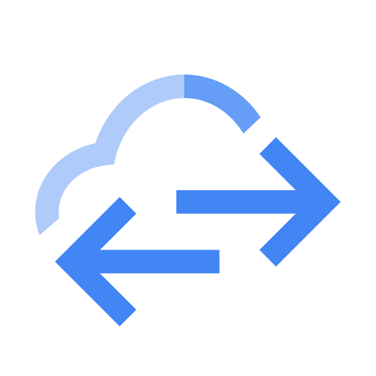

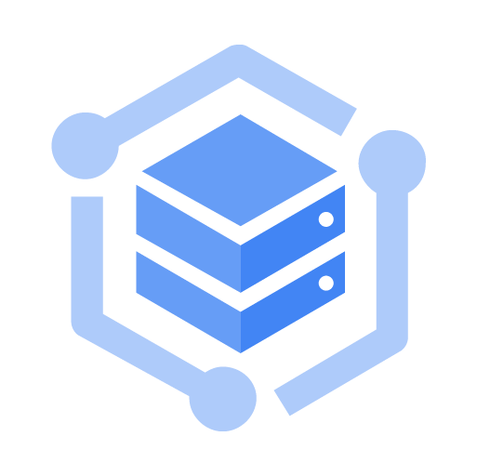

Google Cloud Icons
Storage
Cloud Storage
Filestore
Persistent Disk
Data Transfer
Hybrid and Multicloud
Traffic Director
Anthos
Anthos clusters
Anthos Service Mesh

Slide 6









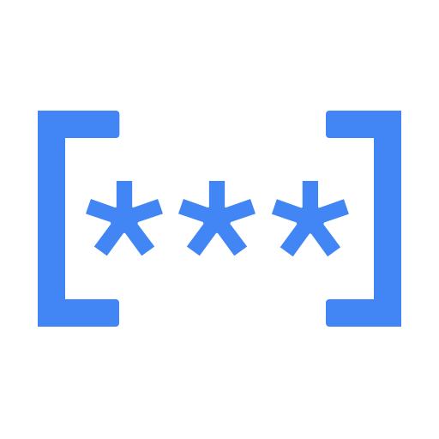






Google Cloud Icons
Security
Cloud Identity
Data Loss
Prevention API
Managed Microsoft AD
Identity & Access Management
Cloud Resource Manager
Web Security Scanner
Cloud Key Management Service
Security Command Center
Security Key Enforcement
Secret
Manager
Migration
Transfer Appliance
Migrate for Compute Engine
Migrate to Containers
Database Migration Service
Storage Transfer Service
Cloud Data Transfer
BigQuery Data Transfer Service

Slide 7





Open Source Icons
Kubernetes
Name Kubernetes
Name Kubernetes
Kubernetes
TensorFlow
Name TensorFlow
Name TensorFlow
TensorFlow
Forseti Security
Name Forseti Security
Name Forseti Security
Forseti Security
Istio
Name Istio
Name Istio
Istio

Slide 8



Diagram Elements: Overview
8
Architecture: Backup and Archive > Disaster Recovery Cold standby server
3
The call-outs below identify the various elements found in a diagram.
1 User Cards 2 User Paths 3 Project/Platform Zone 4 Product Card 5 Zone grouping 6 Expanded Product Card 7 Service Card 8 Title bar (Optional) 9 Footer (Optional)
1
5
4
Instance Group
6
7
2
Cloud DNS
Cloud Load Balancing
Serving Instance Compute Engine
Persistent Disk Snapshot
Multiple Instances
Instance Group
Heartbeat and Snapshot System Compute Engine
Multiple Instances
9

Slide 9


Diagram Elements: User Cards and User Paths
Grey icons represent user or device input.
User elements are located on the left side of the diagram, where the flow originates. A path connects these elements to Google Cloud Platform elements. A name can be used to clarify the user or alternate input method.
User and alternate input icons are 72x72px with a black (#000000) fill at 54% opacity.
Generic User
Specific User
Phone User
Alternate Input
User Name
Mobile Devices
Gateway
Primary Path
2pt | Google Blue | #4284F3
Optional Primary Path
2pt Dashed | Google Blue | #4284F3
Secondary Path
2pt | 38% Black | #9E9E9E
Optional Secondary Path
2pt Dashed | 38% Black | #9E9E9E
Success Status
2pt | Google Green | #34A853
Failure Status
2pt | Google Red | #EA4335

Slide 10







Diagram Elements: Product and Service Cards
Product Card
Expanded Product Card
Service Card
Product and Service information is displayed using Material Design cards.
Product Cards can be single or grouped. Product Cards can display a functional name above the product name for additional clarity.
Expanded Product Cards allow the use of icons and text to identify attributes of the product.
Service cards use a circular icon frame and text wrapped to decrease card width.
Compute Engine
Batch Processing Compute Engine
Local Compute
Multiple Instances
Virtual File System
Analytics Backend Compute Engine
Compute Engine
10GB PD
2
1
Push Notification Service
Analytics Backend Compute Engine
Analytics Backend Compute Engine

Slide 11
Diagram Elements: Zones and Nesting
User 1 (Default) #FFFFFF
System 1 #F1F8E9
Project Zone / Cloud Service Provider #F6F6F6
Zones define project areas and groups within project areas.
Use zones to clarify diagram structure and flow. The user area can also contain zones to clarify user pathways.
All zones have 2px rounded corners.
Zones do not have shadows.
Logical Grouping of Services / Instances #E3F2FD
Region #ECEFF1
Infrastructure System 2 #F3E5F5
External SaaS Providers #FFEBEE
Zone #FFF3E0
Zone #FFF3E0
SubNetwork #EDE7F6
Firewall #FBE9E7
External Data Sources #FFF8E1
Instance Group #F9FBE7
Kubernetes cluster #FCE4EC
colo / dc / on-premises #EFEBE9
External infrastructure 3rd party #E0F2F1
Replica Pool #E0F7FA
pod #E8F5E9
External infrastructure 1st party #E1F5FE
Account #E8EAF6
Optional Component 2pt dashed line #4284F3

Slide 12





Diagram Elements: Zones and Nesting - Specifications
1
Constrained Devices Non-TCP e.g. BLE
2
Standard Devices HTTPS
User Zones:
1 16px padding (all sides)
2 Zone Heading - Roboto Med 16px type / 24px line-height #000000 | 38% opacity
3 Zone Subhead - Roboto Reg 12px type / 16px line-height #000000 | 38% opacity
4 Icon Title - Roboto Reg 12px | #000000 | 87% opacity
5 Icons #000000 | 54% Opacity centered in zones
Storage
3
Cloud Storage
Datastore
Ingest
Pipelines
Cloud Bigtable
Application & Presentation
Pub/Sub
Dataflow
App Engine
Gateway
Monitoring
Analytics
Kubernetes Engine
Dataflow
4
Logging
Compute Engine
BigQuery
Dataproc
5

Slide 13
Diagram Elements: Zones and Nesting - Specifications
1
2
Constrained Devices Non-TCP e.g. BLE
Standard Devices HTTPS
Storage
Project Zone:
1 16px padding top |24px padding right, bottom, left
2 Project Zone - Heading (Optional) Roboto Med 16px type / 24px line-height #000000 | 87% opacity
3 Zone Level 1 - Heading Roboto Med 16px type / 24px line-height #000000 | 38% opacity 8px pad top, 16px Pad left
4 Zone Level 1 - Cards 8px padding top, right, bottom, left and between cards
Cloud Storage
3
Datastore
Ingest
Pipelines
Cloud Bigtable
Application & Presentation
Pub/Sub
Dataflow
App Engine
Gateway
Monitoring
Analytics
Kubernetes Engine
Dataflow
Logging
Compute Engine
BigQuery
4
Dataproc

Slide 14

Diagram Elements: Zones and Nesting - Specifications
1
Project Zone Exceptions:
1 Stacked cards need additional padding due to shadow width.
+ 8px padding right, bottom and, left
ZONE 1
ZONE 1
Batch Processing Compute Engine
Analytics Backend Compute Engine
+8px
+8px
Multiple Instances
+8px
Stacked card with additional padding
Standard card with normal padding

Slide 15
Diagram Elements: Title and Footer Bars
Title Bar
An optional Title and Footer bar can be added to diagrams if needed.
The Title and Footer bars create a polished and complete look when used with a diagram.
Architecture: App Engine and Cloud Endpoints
Footer Bar

Slide 16

Icons and Material Design
Material Design icons are simple, modern, friendly, and sometimes quirky. Each icon is reduced to its minimal form. The designs ensure readability and clarity even at small sizes.
Use these icons to create specific User and Device Cards or Service Cards while maintaining a consistent visual look.
Material icons can be searched and downloaded directly from material.io/tools/icons/
TIP: Use black icon then set transparency to 46% in “Format > Format Options” to match icon color.
Sample of Material icons
Notes:
TIP: Use black icon then set transparency to 46% in “Format > Format Options” to match icon color.

Slide 17


















User and Device Cards
One Line
Two Line

Slide 18


















Service Cards
Gateway
Task Queues
Application System(s)
Network Load Balancer
Blank One Line
Memcache
Image Services
Virtual File System
Blank One Line
Google Network W/ Edge Cache
Logs API
Dedicated Game Server
CDN Interconnect
Blank Two & Three Line
Push Notification Service
Cluster
Frontend Platform Services
Scheduled Tasks
Blank Two & Three Line
NAT
Google Edge POP
HTTPS Load Balancer
Squid Proxy
External Payment Form
Persistent Disk Snapshot
Bucket
Internal Payment Authorization
Persistent Disk
Service Discovery
VPN Gateway

Slide 19

Zones
User 1 (Default) #FFFFFF
System 1 #F1F8E9
Project Zone / Cloud Service Provider #F6F6F6
Logical Grouping of Services / Instances #E3F2FD
Region #ECEFF1
Infrastructure System 2 #F3E5F5
External SaaS Providers #FFEBEE
Zone #FFF3E0
Zone #FFF3E0
SubNetwork #EDE7F6
Firewall #FBE9E7
External Data Sources #FFF8E1
Instance Group #F9FBE7
Kubernetes cluster #FCE4EC
colo / dc / on-premises #EFEBE9
External infrastructure 3rd party #E0F2F1
Replica Pool #E0F7FA
pod #E8F5E9
External infrastructure 1st party #E1F5FE
Account #E8EAF6
Optional Component 2pt dashed line #4284F3

Slide 20
Product Cards
Compute
Compute Engine
Name Compute Engine
Name Compute Engine
Cloud GPUs
Name Cloud GPUs
Name Cloud GPUs
App Engine
Name App Engine
Name App Engine
Cloud Functions
Name Cloud Functions
Name Cloud Functions
Google Kubernetes Engine
Name Google Kubernetes Engine
Name Google Kubernetes Engine
Container- Optimized OS
Name Container-Optimized OS
Name Container-Optimized OS
Cloud Run
Name Cloud Run
Name Cloud Run
Anthos clusters
Name Anthos clusters
Name Anthos clusters

Slide 21




Product Cards
API Management
API Analytics
Name API Analytics
Name API Analytics
Apigee Sense
Name Apigee Sense
Name Apigee Sense
API Monetization
Name API Monetization
Name API Monetization
Cloud Endpoints
Name Cloud Endpoints
Name Cloud Endpoints
Apigee API Platform
Name Apigee API Platform
Name Apigee API Platform
Developer Portal
Name Developer Portal
Name Developer Portal

Slide 22



Product Cards
Security
IAM
Name IAM
Name IAM
Name BeyondCorp
Data Loss Prevention API
Name Data Loss Prevention API
Cloud Resource Manager
Name Cloud Resource Manager
Name Cloud Resource Manager
Name Data Loss Prevention API
Web Security Scanner
Name Web Security Scanner
Name Web Security Scanner
Identity-Aware Proxy
Name Identity-Aware Proxy
Key Management Service
Name Key Management Service
Name Key Management Service
Name Identity-Aware Proxy
Name Security Command Center
Name Security Command Center
Security Key Enforcement
Name Security Key Enforcement
Name Security Key Enforcement

Slide 23
Product Cards
Data Analytics
BigQuery
Name BigQuery
Name BigQuery
Dataflow
Name Dataflow
Name Dataflow
Pub/Sub
Name Pub/Sub
Name Pub/Sub
Dataproc
Name Dataproc
Name Dataproc
Cloud Life Sciences
Name Cloud Life Sciences
Name Cloud Life Sciences
Dataprep
Name Dataprep
Name Dataprep
Cloud Composer
Name Cloud Composer
Name Cloud Composer
Data Catalog
Name Data Catalog
Name Data Catalog
Cloud Data Fusion
Name Cloud Data Fusion
Name Cloud Data Fusion
Analytics Hub
Name Analytics Hub
Name Analytics Hub

Slide 24
Product Cards
Data Transfer
Transfer Appliance
Name Transfer Appliance
Name Transfer Appliance

Slide 25










Product Cards
AI and Machine Learning
AI Platform
Name AI Platform
Name AI Platform
Natural Language API
Name Natural Language API
Name Natural Language API
Vertex AI
Name Vertex AI
Name Vertex AI
Vision API
Name Vision API
Name Vision API
Translation API
Name Translation API
Name Translation API
Speech-to-Text
Name Speech-to-Text
Name Speech-to-Text
Job Search
Name Job Search
Name Job Search
Cloud Video Intelligence API
Name Cloud Video Intelligence API
Advanced Solutions Lab
Name Advanced Solutions Lab
Name Advanced Solutions Lab
AutoML
Name AutoML
Name AutoML

Slide 26





Product Cards
Internet of Things
IoT Core
Name IoT Core
Name IoT Core
Databases
Cloud SQL
Name Cloud SQL
Name Cloud SQL
Cloud Bigtable
Name Cloud Bigtable
Name Cloud Bigtable
Cloud Spanner
Name Cloud Spanner
Name Cloud Spanner
Memorystore
Name Memorystore
Name Memorystore
Firestore
Name Firestore
Name Firestore
Datastore
Name Datastore
Name Datastore
AlloyDB
Name AlloyDB
Name AlloyDB

Slide 27

Product Cards
Storage
Cloud Storage
Name Cloud Storage
Name Cloud Storage
Persistent Disk
Name Persistent Disk
Name Persistent Disk
Filestore
Name Filestore
Name Filestore

Slide 28

Product Cards
Operations
Cloud Monitoring
Name Cloud Monitoring
Name Cloud Monitoring
Deployment Manager
Name Deployment Manager
Name Deployment Manager
Cloud Logging
Name Cloud Logging
Name Cloud Logging
Cloud Console
Name Cloud Console
Name Cloud Console
Error Reporting
Name Error Reporting
Name Error Reporting
Cloud Shell
Name Cloud Shell
Name Cloud Shell
Cloud Trace
Name Cloud Trace
Name Cloud Trace
Cloud Mobile App
Name Cloud Mobile App
Name Cloud Mobile App
Cloud Profiler
Name Cloud Profiler
Name Cloud Profiler
Cloud Billing API
Name Cloud Billing API
Name Cloud Billing API
Cloud APIs
Name Cloud APIs
Name Cloud APIs

Slide 29
Product Cards
Networking
Virtual Private Cloud
Name Virtual Private Cloud
Name Virtual Private Cloud
Cloud Interconnect
Name Cloud Interconnect
Name Cloud Interconnect
Cloud Load Balancing
Name Cloud Load Balancing
Name Cloud Load Balancing
Cloud DNS
Name Cloud DNS
Name Cloud DNS
Cloud CDN
Name Cloud CDN
Name Cloud CDN
Cloud Network
Name Cloud Network
Name Cloud Network
Cloud External IP Addresses
Name Cloud External IP Addresses
Name Cloud External IP Addresses
Cloud Routes
Name Cloud Routes
Name Cloud Routes
Cloud Firewall Rules
Name Cloud Firewall Rules
Name Cloud Firewall Rules
Cloud VPN
Name Cloud VPN
Name Cloud VPN
Cloud Router
Name Cloud Router
Name Cloud Router
Cloud Armor
Name Cloud Armor
Name Cloud Armor
Standard Network Tier
Name Standard Network Tier
Name Standard Network Tier
Premium Network Tier
Name Premium Network Tier
Name Premium Network Tier
Partner Interconnect
Name Partner Interconnect
Name Partner Interconnect

Slide 30


Product Cards
CI / CD
Cloud SDK
Name Cloud SDK
Name Cloud SDK
Cloud Build
Name Cloud Build
Name Cloud Build
Gradle App Engine Plugin
Name Gradle App Engine Plugin
Name Gradle App Engine Plugin
Cloud Tools for Visual Studio
Name Cloud Tools for Visual Studio
Cloud Source Repositories
Name Cloud Source Repositories
Name Cloud Source Repositories
Name Cloud Tools for Visual Studio
Maven App Engine Plugin
Name Maven App Engine Plugin
Name Maven App Engine Plugin
Name Cloud Tools for Eclipse
Name Cloud Tools for Eclipse
Cloud Tools for IntelliJ
Name Cloud Tools for IntelliJ
Name Cloud Tools for IntelliJ
Cloud Test Lab
Name Cloud Test Lab
Name Cloud Test Lab
Cloud Tools for PowerShell
Name Cloud Tools for PowerShell
Name Cloud Tools for PowerShell
IDE plugins
Name IDE plugins
Name IDE plugins
Artifact Registry
Name Artifact Registry
Name Artifact Registry

Slide 31




Expanded Product Cards
Name Compute Engine
Name Compute Engine
Name BigQuery
Name BigQuery
App Engine
App Engine
10GB PD
10GB PD
Attribute Name
Attribute Name
Attribute Name
Attribute Name
1
1
1
1
1
123
Name App Engine
Name App Engine
Name Dataflow
Name Dataflow
Dataflow
Dataflow
10GB PD
10GB PD
Attribute Name
Attribute Name
Attribute Name
Attribute Name
1
1
1
1
1
123
Name GKE
Name GKE
Name Cloud Storage
Name Cloud Storage
GKE
GKE
10GB PD
10GB PD
Attribute Name
Attribute Name
Attribute Name
Attribute Name
1
1
1
1
1
123
Name Cloud Bigtable
Name Cloud Bigtable
Name Pub/Sub
Name Pub/Sub
Dataproc
Dataproc
10GB PD
10GB PD
Attribute Name
Attribute Name
Attribute Name
Attribute Name
1
1
1
1
1
123
Name Cloud SQL
Name Cloud SQL
Compute Engine
Compute Engine
10GB PD
10GB PD
Attribute Name
Attribute Name
1
1
1
1
1
123

Slide 32
Title bar, Footer bar, Project Zone, Notes, Markers, and Legend
Architecture: App Engine and Cloud Endpoints

Slide 33



Gaming > Mobile Game Backend
Architecture: Gaming > Mobile Game Backend
Apple Push Notification Service
Sockets API
Google Cloud Messaging
Scheduled Tasks
iOS
Logs API
Mobile Game Backend App Engine
Batch Processing Compute Engine
Cloud Endpoints
Task Queues
Cloud Endpoint Clients
Multiple Instances
Android
Multiple Instances
Optional Components
AdMob
Memcache
Datastore
Image Services
Cloud Storage
BigQuery
Google Play Game Services

Slide 34

Digital Marketing > Publisher side analysis
Presentation Layer
Analysis Layer
Processing & Analysis Layer
Storage Layer
CMS App Engine
BI Interface Data Studio 360
Managed Data Warehouse BigQuery
Ingestion Layer
or
E-commerce Platform App Engine
Image Analysis Vision API
Managed Data Warehouse Cloud SQL
Experiences
TensorFlow
Container Infra GKE/Kubernetes
Columnar/NoSQL Cloud Bigtable
or
Web/Mobile Application App Engine
Dataproc
Production Storage Cloud Storage
ETL Dataflow
Archival Storage Cloud Storage Nearline
Ingestion Layer
Data Sources
Dataflow
Pub/Sub
Batch Processing
1st Party Cluster
Google Marketing Platform
Real-time Analytics
2nd Party Cluster
Dataproc
BigQuery
Compute Engine
3rd Party Cluster

Slide 35


Digital Marketing > Real-Time Bidding
us-east
europe-west
us-central
asia-east
Data Proxy Servers Compute Engine
Data Proxy Servers Compute Engine
Ad Manager
Bid Servers Compute Engine
Database Bid Compute Engine
Database Bid Compute Engine
Cloud Load Balancing
Pixel Servers Compute Engine
Database User Compute Engine
Database User Compute Engine
Analytics
Campaign management

Slide 36
Dev Test > Continuous Delivery with Spinnaker
Development Team
us-east1-d
Code Repository DevTools
Test Instances Compute Engine
1
2
Build Artifact
Spinnaker Compute Engine
Prod Instances Compute Engine
5
Users
3
Autoscaler
Cloud Image Compute Engine
Cloud Load Balancing
4
Build Artifact
6
us-central1-f
Prod Instances Compute Engine
Autoscaler
1 Commit code
2 Detect code change
3 Build immutable image
4 Launch test instance from image
5 Run tests
6 Perform rolling update of image to autoscaler

Slide 37
Dev Test > Jenkins on k8s
End Users
Developers
Production Namespace
Code Repository DevTools
Frontend ReplicationController
Cloud Load Balancing
1
2
Jenkins Namespace
Backend ReplicationController
Jenkins controller Pod
7
3
Staging Namespace
Ops & Quality
Jenkins replica ReplicationController
Frontend ReplicationController
4
6
Docker Images Container Registry
Backend ReplicationController
5
1 Commit Code
2 Code Enters CD Pipeline
3 Test/Build Job Submitted to replica
4 Push Docker images
5 Images Deployed to Staging
6 Operational and Functional Testing
7 Images Deployed to Production

Slide 38
Websites > Dynamic Hosting
Architecture: Websites > Dynamic Hosting
Zone 1
us-central 1-a
Instance Group Compute Engine
Primary Cloud SQL
Web Applications
Cloud Load Balancing
Zone 2
Replication
us-central 1-f
Instance Group Compute Engine
Read Replica Cloud SQL
Web Applications

Slide 39
Mobile > Mobile Game Backend
Architecture: Mobile > Mobile Game Backend
Apple Push Notification Service
Sockets API
Google Cloud Messaging
Scheduled Tasks
iOS
Logs API
Mobile Game Backend App Engine
Batch Processing Compute Engine
Cloud Endpoints
Task Queues
Cloud Endpoint Clients
Multiple Instances
Android
Multiple Instances
Optional Components
AdMob
Memcache
Datastore
Image Services
Cloud Storage
BigQuery
Google Play Game Services

Slide 40
Retail > PCI
Architecture: Retail > PCI
External Payment Processor
Customer Payment Requests HTTPS
Virtual Private Cloud
External Payment Form
Internal Payment Authorization
Application Network
Cloud Load Balancing
NAT
VPN Gateway
VPN Gateway
Squid Proxy
Application System(s)
Cloud Logging
BigQuery
Cloud Monitoring

Slide 41
Web Resources
Icon and sample diagrams landing page https://cloud.google.com/icons
Google Cloud Architecture Diagramming Tool https://googlecloudcheatsheet.withgoogle.com/architecture

Slide 42
Data Integration >
Architecture: Data Integration
Data Integration
Marketing Audience Data Sets
ps1 Pub/Sub
cf1 Cloud Functions
df1 Dataflow
Core BigQuery
Rules Actions
sch1 Cloud Scheduler
cf2 Cloud Functions
df2 Dataflow
Archive BigQuery
Inventory APIs
Program Res BigQuery
b1 Cloud Storage
cf3 Cloud Functions
df3 Dataflow
Data Core View BigQuery
b2 Cloud Storage
cf4 Cloud Functions
df4 Dataflow
b3 Cloud Storage
df5 Dataflow
Logs BigQuery
cf5 Cloud Functions

